Slide 1


Ensuring Safe Composition of Distributed Processes
Jacob Beal
QA4SASO Workshop
@ IEEE SASO
September, 2015

Slide 2
A generative approach to safety
Restrict your development environment…
… to contain only resilient distributed systems.

Slide 3
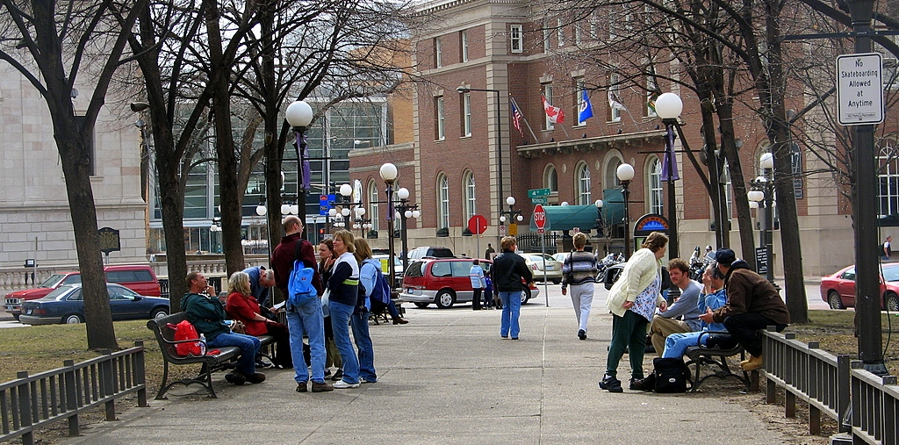
Everything is a wireless computer

Slide 4
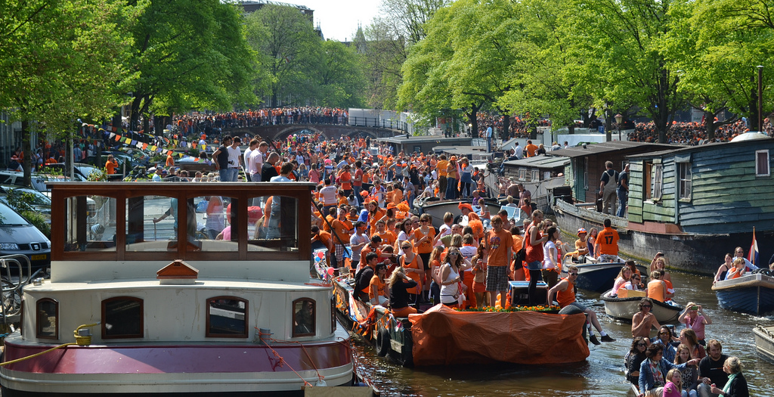
Example: Services for Mass Events

Slide 5
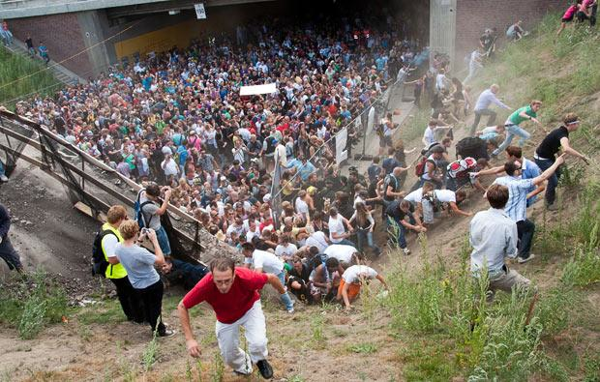
Example: Managing Crowd Danger
Notes:
Love Parade disaster: electronic music festival in Duisberg, Germany in 2010. Many more people came then expected (possibly as many as 1.4 million to an old freight stations holding a max of 250K), and a mass panic caused 21 deaths and 510 injuries.

Slide 6

Distributed services are complex
Dispersal Advice
Congestion-Aware Navigation
Dangerous Density Warning
Crowd Estimation
How to make engineering resilience tractable?

Slide 7

Aggregate Programming

Slide 8
Aggregate Programming Stack

Slide 9
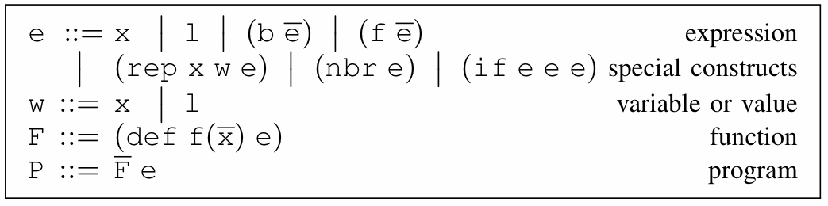
Field Calculus
State
Variable
Literal Value
Local Ops
Communication
Domain Change
Abstract & Call
Functions
[Viroli et al., ‘13, Damiani et al., ‘15]

Slide 10
Field Calculus is Space-Time Universal
Space-time Universal = arbitrarily good approximation of any causal, finitely-approximable computation
Specification:
Acausal
Non-approximable
[Beal, ’10; Beal et al., SCW 14]

Slide 11
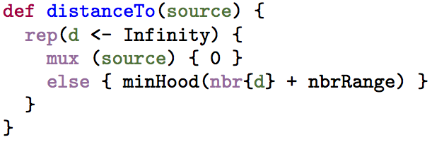
Instantiation: Protelis
Java-hosted & integrated
Java-like syntax
Eclipse support
Architecture:
[Pianini, Viroli, & Beal, SAC ‘15]

Slide 12
Aggregate Programming Stack

Slide 13
Self-Stabilizing Building Blocks
G
Information spreading
C
Information collection
T
Short-term memory
4
3
1
7
1
3
3
0
2
Resilience by construction: all programs from these building blocks are also self-stabilizing!

Slide 14
Applying building blocks:
Example API algorithms from building blocks:
distance-to (source) max-likelihood (source p)
broadcast (source value) path-forecast (source obstacle)
summarize (sink accumulate local null) average (sink value)
integral (sink value) region-max (sink value)
timer (length) limited-memory (value timeout)
random-voronoi (grain metric) group-size (region)
broadcast-region (region source value) recent-event (event timeout)
distance-avoiding-obstacles (source obstacles)
Since based on these building blocks, all programs built this way are self-stabilizing!

Slide 15
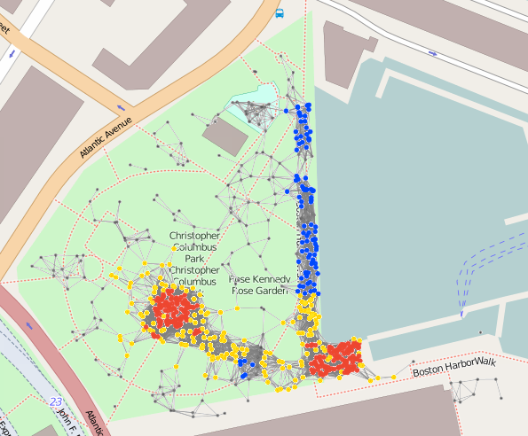
Complex Example: Crowd Management
(def crowd-tracking (p)
;; Consider only Fruin LoS E or F within last minute
(if (recently-true (> (density-est p) 1.08) 60)
;; Break into randomized ‘‘cells’’ and estimate danger of each
(+ 1 (dangerous-density (sparse-partition 30) p))
0))
(def recently-true (state memory-time)
;; Make sure first state is false, not true...
(rt-sub (not (T 1 1)) state memory-time))
(def rt-sub (started s m)
(if state 1 (limited-memory s m)))
(def dangerous-density (partition p)
;; Only dangerous if above critical density threshold...
(and
(> (average partition (density-est p)) 2.17)
;; ... and also involving many people.
(> (summarize partition + (/ 1 p) 0) 300)))
(def crowd-warning (p range)
(> (distance-to (= (crowd-tracking p) 2))
range)
(def safe-navigation (destination p)
(distance-avoiding-obstacles
destination (crowd-warning p)))
18 lines non-whitespace code
10 library calls (21 ops)
IF: 3 G: 11 C: 4 T: 3

Slide 16
Optimization of Dynamics
See our talk in the main program of SASO!

Slide 17
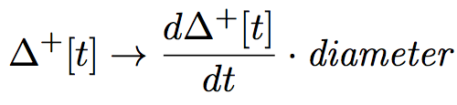
Predicting and Controlling Dynamics
Distance estimate: prediction from transient response:
See our talk in the FOCAS/SCOPES workshop!

Slide 18
Aggregate Programming Stack

Slide 19
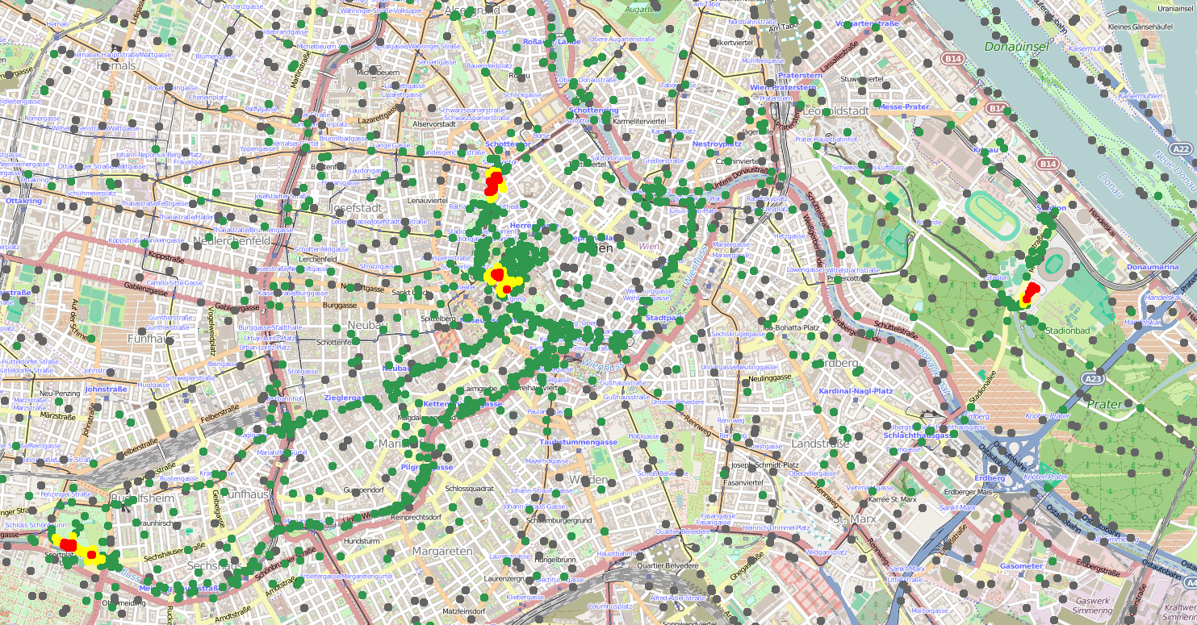
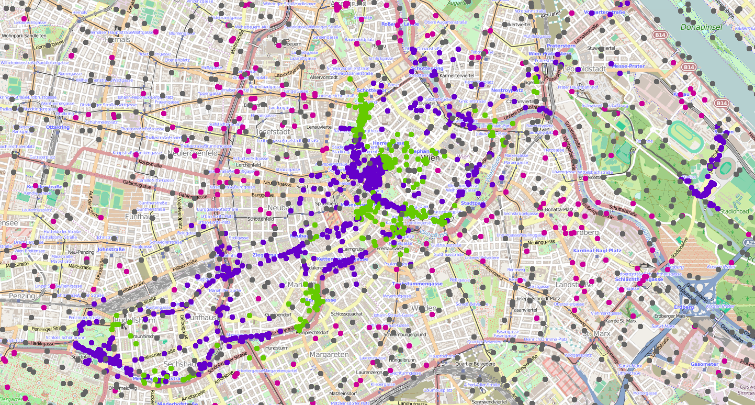
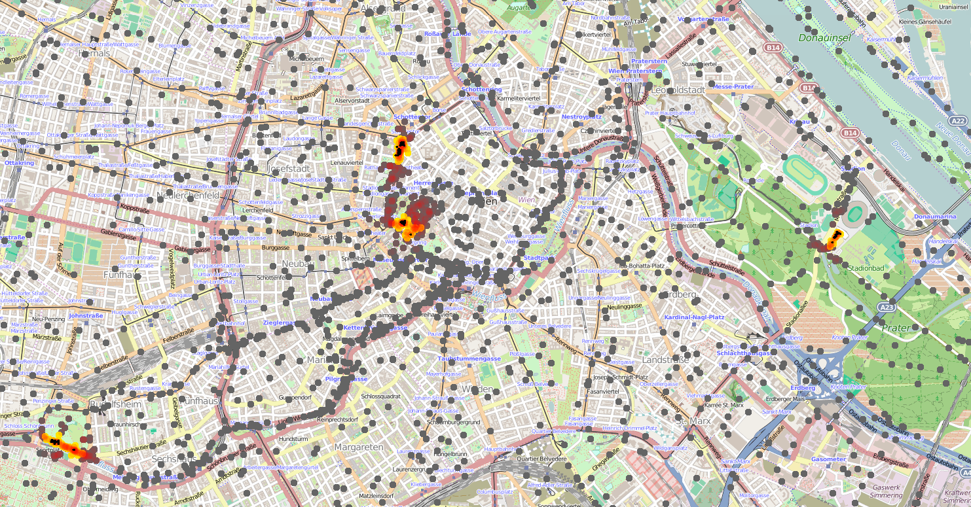
Crowd Safety Services
^{def dangerousDensity(p, r) {}
let mr = managementRegions(r*2, () -> { nbrRange });
let danger = average(mr, densityEst(p, r)) > 2.17 &&
summarize(mr, sum, 1 / p, 0) > 300;
if(danger) { high } else { low }
}
^{def crowdTracking(p, r, t) {}
let crowdRgn = recentTrue(densityEst(p, r)>1.08, t);
if(crowdRgn) { dangerousDensity(p, r) } else { none };
}
def crowdWarning(p, r, warn, t) {
distanceTo(crowdTracking(p,r,t) == high) < warn
}
Dissemination of new versions
Pre-emptive modulation of priorities

Slide 20
Dependency-Directed Recovery
Dramatically better recovery time
Identify & shut down
affected services
Non-dependent
services still run
Fewer services disrupted
See our talk in the main program of SASO!

Slide 21

Distributed Rewind and Replay

Slide 22
Tactical Cloud Services

Slide 23
Summary: Aggregate Methodology
restrict

Slide 24




Acknowledgements
Shane Clark
Partha Pal
Kyle Usbeck
Mirko Viroli
Danilo Pianini
Soura Dasgupta
Raghu Mudumbai
Amy Kumar
Ferruccio Damiani

